Slide 1
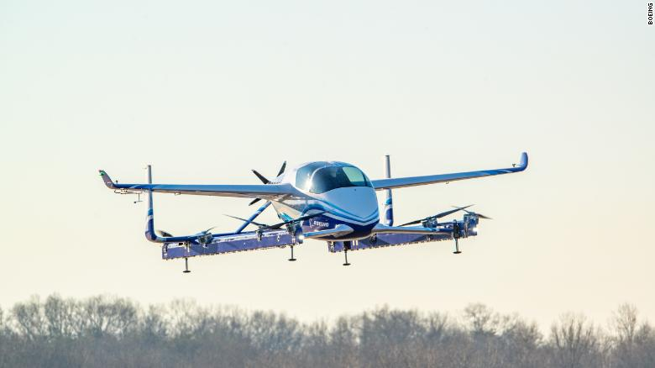
Problem statement
PolyHack 2019
Controlled under the Export Administration Regulations as ECCN 9E991. Confirm authorized nationalities prior to disclosure.

Slide 2
Overview
Introduction to the challenge
Overview of the problem
Proposed visualization
Problem constraints
Vertiport model
Problem grading/ objective function
Level 1: the basic hub and spoke network
Level 2: the commuter problem
Level 3: a not so basic hub and spoke network

Slide 3


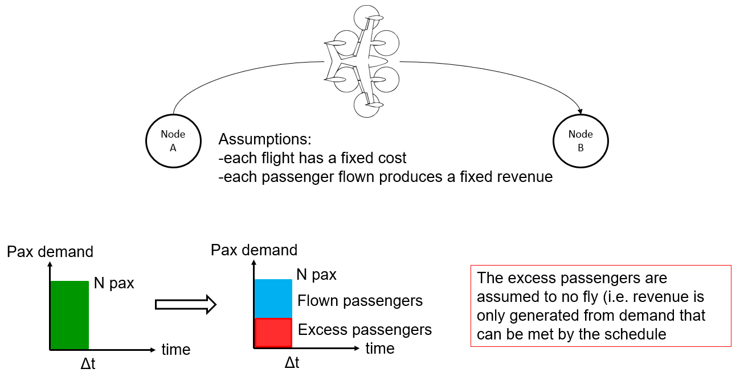
Introduction & context
Aurora Swiss Aerospace is designing air-taxi vehicles and is interested in understanding how to operate them in the best way
The business model depends on how well the vehicles are routed, in order to generate maximum revenue
B
E
A
D
C
Vertiport
Direct route

Slide 4
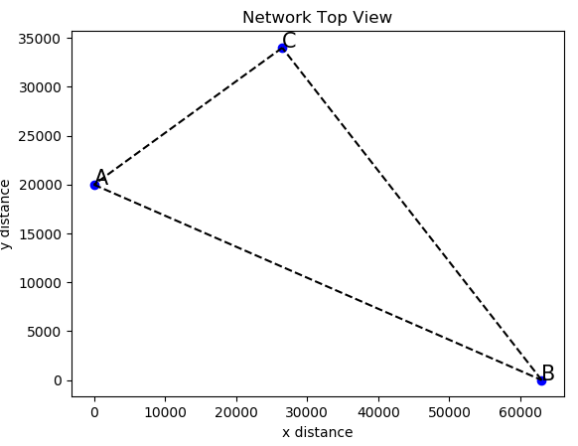
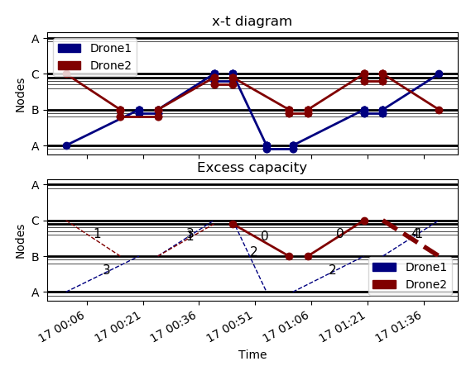
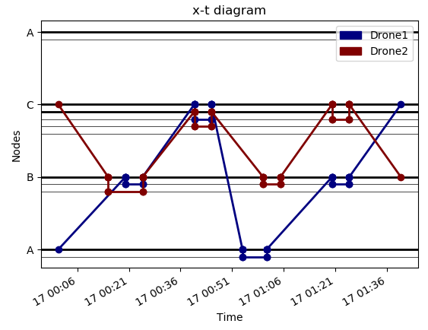
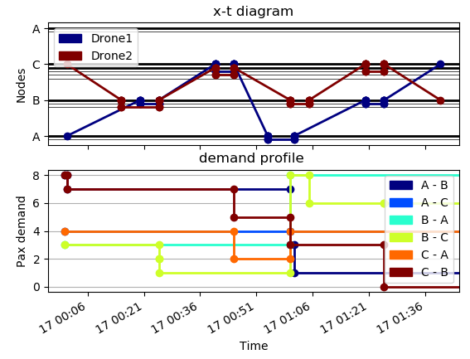
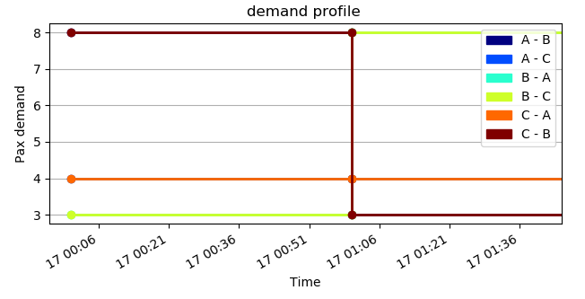
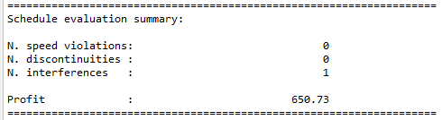

Overview of the problem
0.) Boundary conditions/ input:
1.) Output:
2.) Post-processing & grading
Network
=
+
Demand profile
Schedule
+
Vehicles & other parameters

Slide 5
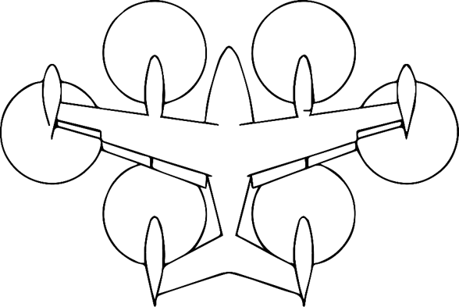
Proposed visualization
Use of an ‘x-t’ diagram (special dimensions are collapsed on y axis and time is x axis)
Physical representation:
X-t visualization:
Flight A -> B
Schedule description
B
A
B
A
Flight B -> A
t1
t2
t3
t4
Schedule:
Flight A -> B: T.O. = t1, LND= t2
Flight B-> A: T.O. = t3, LND=t4

Slide 6


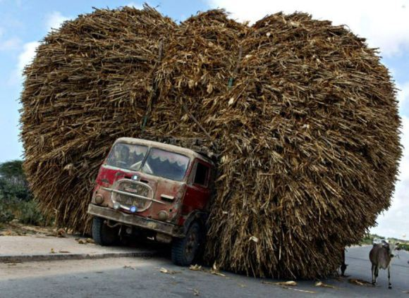
Problem constraints
X-t visualizations:
B
No teleporting
No time travel
No overloading of airplanes
A
t1
t2
t3
t4
B
A
t1
t2
t4
t3
B
532
A
t1
t2
t3
t4

Slide 7


Problem constraints
X-t visualizations:
No speeding
No passenger creation
B
A
t1
t2
t4
t3
Demand AB
0
t1

Slide 8
Vertiport model
outbound
FATO (approach corridor)
FATO transit
FATO transit
vertiport
H
Other vehicle on gate
inbound
Turn-around time
Gate
1
Gate
N
Gate
j
x
Vertiport can have N vehicles (i.e. gates) at vertiport
t
Physical representation
X-t representation

Slide 9
Problem grading/ Objective function
Node A
Assumptions:
-each flight has a fixed cost
-each passenger flown produces a fixed revenue
Node B
Pax demand
Pax demand
N pax
N pax
The excess passengers are assumed to no fly (i.e. revenue is only generated from demand that can be met by the schedule
Flown passengers
Excess passengers
time
time
Δt
Δt
Goal: fill up the aircraft without violating any constraints!

Slide 10
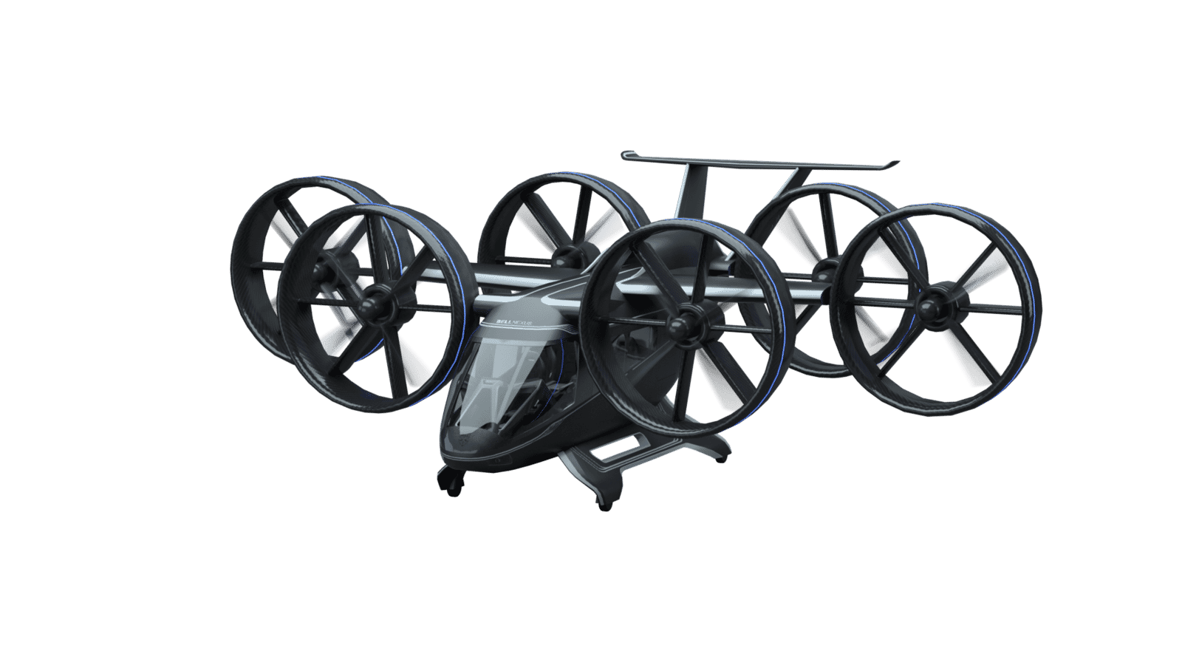
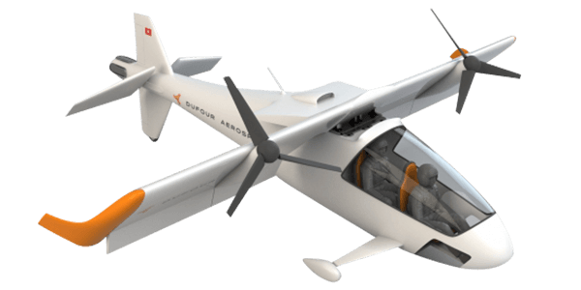
Level 1: the basic hub and spoke network
 | n. | Type | N pax max | Speed range | Cost/km
 | 1 | Big | 4 | 50-60 m/s | 4 USD/km
 | 3 | Small | 2 | 50-60 m/s | 2.5 USD/km
~10 min
C
2 gates
A
2 gates
~15 min
~20 min
y
B
2 gates
Demand profile:
-Step in time, with B being the hub
x
AB, CB
BA, BC
AC, CA
y
y
y
1h
2h
1h
2h
1h
2h

Slide 11
Level 2: the commuter problem
 | n. | Type | N pax max | Speed range | Cost/km
 | 2 | Big | 4 | 50-60 m/s | 4 USD/km
 | 4 | Small | 2 | 50-60 m/s | 2.5 USD/km
~10 min
B
2 gates
A
2 gates
~15 min
~10 min
E
5 gates
Demand profile:
-Hub & spoke, with spokes connected lightly
y
C
2 gates
~10 min
y
Rush-hour
Rush-hour
x
~20 min
EA…
D
2 gates
AE…
t
Δt=0.5h
y
6 hours
AB, BA,
BC, CB
t

Slide 12
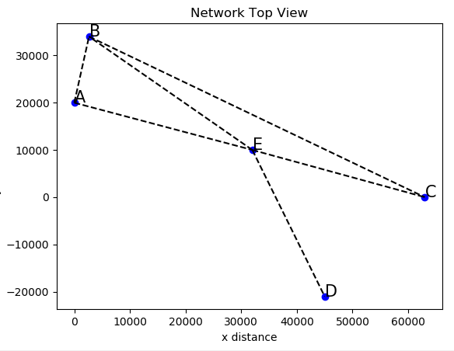
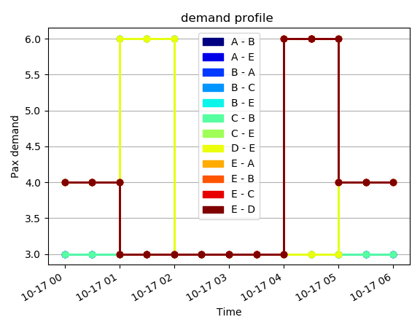
Level 2: the commuter problem

Slide 13
Level 3: A not so basic hub and spoke network
 | n. | Type | N pax max | Speed range | Cost/km
 | 4 | Big | 4 | 50-60 m/s | 4 USD/km
 | 5 | Small | 2 | 50-60 m/s | 2.5 USD/km
G
F
H
~10 min
B
A
~15 min
Concept:
Generalize the previous network and demand profiles so that no obvious pattern may be found by “hand”. Demand is random (see next slide)
~10 min
E
y
C
~10 min
x
~20 min
D
I

Slide 14
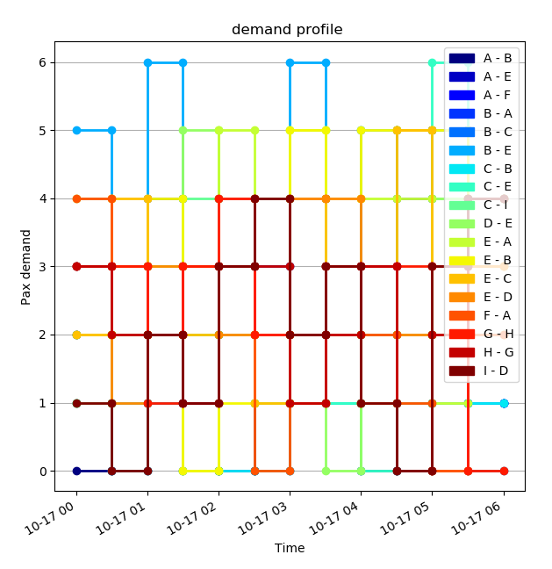
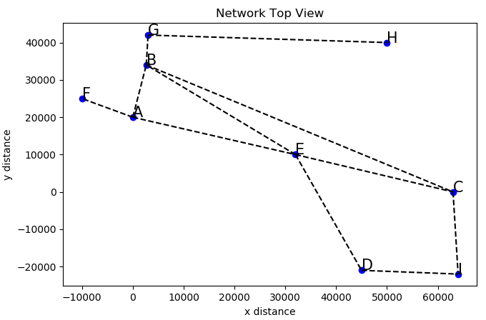
Level 3: A not so basic hub and spoke network

